Slide 1
The Background and Chemistry of Witchcraft
By Johannes Johnston
Literature 2111

Slide 2
Background
The hunting of witches started in the middle of the 14th to the late 18th Century
Estimate of 40,000 to millions of people were burned, hanged, or tortured for witchcraft.
Mostly older poor women were accused, but many other people too of different ages, genders, and ranks were put to death due to witchcraft.
Before witch hunts in the middle ages, magic had already been acknowledged by civilization.
Legends of ancient. Civilizations talks about the supernatural. People that take on animal form, monsters, half man and half beast, enchanters, ghosts, etc.
Any magic performed outside of church was considered the work of Satan

Slide 3
More background
90% of the accused were women
Between 1500-1650 there were almost no women left in some Swiss villages.
In Germany there were some villages that had the whole population wiped out and burned at the stake.
In England the witches were subjected to the water test.
    The accused person would be trussed and thrown into a pond to see whether the convicted was a witch or not. If he or she floated, then they were a witch and had to face the punishment of hanging but if they drowned, then they were not a witch.

Slide 4
More background
The craze of witch hunting did not cease very quickly
Most countries didn’t stop the killing of “witches” until the beginning of the 17th century until the end of the 18th century.
Public opinions of witches still remained harsh.
Many of these women that were accused were herbalists. These women could cure diseases and treat others. “They were often relied on for love potions, to cast spells and to remove hexes” (Napoleon’s Buttons, 227).

Slide 5
Before 1350
Witchcraft was considered sorcery. Sorcery is controlling nature to one’s own interest.
This was an accepted way of life.
If anyone did do harm to you from witchcraft, you could seek legal recourse from a witch, but if you can’t prove them guilty, then you would have to pay a penalty and trial costs.
Witches were rarely put to death

Slide 6
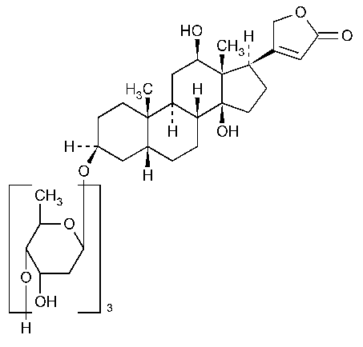
chemicals that affect the heart
Accused witches used different types herbs to either heal or harm.
Digitalis, an extract from the foxglove Digitalis purpurea, contains molecules that have an effect on the heart, also known cardiac glycosides.
They reduce heart rate, regulates heart rhythm, and strengthens heartbeat
Molecules that affect the heart are also found in animals especially amphibians.
Many potions prepared by witches were said to have parts of toad.
The molecule bufotoxin is a venom found in the commomn European toad, Bufo Vulgaris.
It is one of the most toxic chemicals known to human kind.

Slide 7

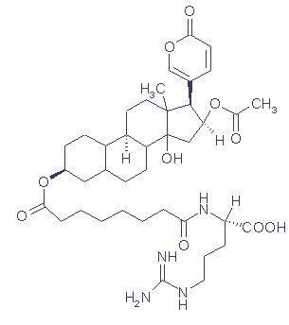
Chemicals that affect the heart

Slide 8
Chemicals that affect the heart
The structure of the bufo vulgaris molecule is similar in structure to the digitoxin molecule other than an added OH and a six membered, instead of a five membered lactone ring.

Slide 9
Greases and ointments
Witches usually used different types of extracts of plants that are apart of the nightshade family to promote flying.
The mandrake plant (Mandragora officinarum)has been used since ancient times for restoring sexual vitality and as a soporific.
Belladona plant (Atropa belladona) which have been used to dilating eyes by dropping the juice into their eyes. More taken would give you a deathlike slumber
Henbane plant (Hyoscyamus niger) has been used as a pain reliever, anesthetic, and possibly a poison.
They all contain alkaloids compounds that have one or more nitrogen atoms.

Slide 10
Greases and ointments
These alkaloids were not soluble in water and could lead to death if they were swallowed.
These three plants were dissolved as fats or oils and then applied to the skin. The skin would absorb it via transdermal delivery.
Absorption is easier at the places where the skin is the thinnest and blood vessels are just beneath the surface.
Witches must have known this since they usually rubbed it into some private areas
Two forms that these alkaloid molecules could take on was autropine and scopolamine.

Slide 11
Greases and ointments
These two molecules have effects of euphoria, hallucinations, and anesthetics.
They gave witches the sense of flying, distorted visions,, euphoria, hysteria, feelings of leaving the body, and encounters with wild beasts.
Witches would confess to flying out to masses and doing sexual things.
The witches were not really flying off with broomsticks, but instead they were high and did sexual activities with the broomsticks to themselves and other witches while having crazy sexual fantasies.
An example of another alkaloid known to humans is cocaine

Slide 12
Alkaloids
The Ergot fungus which contains the alkaloid Claviceps purpurea infects many cereal grains and especially rye.
It was indirectly a cause to thousands of witch burnings in Europe.
It brought on the suffering of many communities in Europe with symptoms like convulsion, seizures, lethargy, manic behavior, hallucination, vomiting twitching and many other painful symptoms like gangrene.
This disease gained various names like: holy fire, occult fire, Saint Vitus’ dance, and Saint Anthony’s fire.
During just a short rainy period, the fungus could grow on rye.
This would wipe out towns of people

Slide 13
Alkaloids
After a village would notice that they were the only village infected when other adjacent towns where, people started to point out that they have been bewitched.
Like many other natural disasters, the Elderly women were blamed the most. This could have been de to their inability to bear children and lack of family.
Women like these lived on the outskirts of their community and relied on their herbalist skills, and were too poor to even afford the money to pay for flour from the miller in town. Being the only one untouched by the ergot raises more suspicion.
There have been many outbreaks from ergot in history like Julius Caesar’s legion which caused great suffering and a reduction of effectiveness of his army.

Slide 14
Alkaloids
A number of experts have come to conclusion that ergot poisoning was responsible for approximately 250 people during 1692 in Salem, Massachusetts.
In the late 17th century, rye was grown in the area. During the Spring and Summer of 1691 there have been records of warm and rainy weather. This leads to the fungus easily being grown.
Among the 30 victims, most were girls or young women. Young people are more susceptible to ergot poisoning.
Alkaloids of ergot , although toxic and dangerous, have been used over the centuries to hasten childbirth or produce abortions.
Today chemical modifications of ergot alkaloids are used as vasoconstrictors for migraines, postpartum bleeding and uterine contractions for childbirth.

Slide 15
Lysergic acid
Alkaloids of ergot have derivatives from lysergic acid.
A chemist named Albert Hoffman prepared a derivative that he would name LSD-25.
Thinking he was cautions when testing it out, he swallowed a quarter of a milligram, which is five times the amount to produce a hallucinogenic affect.
LSD is 10,000 more potent than the hallucinogen in naturally occurring mescaline, found in the peyote cactus.

Slide 16
Conclusion of Alkaloids
Atropine and ergot Alkaloids did not cause witchcraft, however it did interpret as evidence against many women, usually the poorest and most vulnerable in society.
They were accused as witches since they claimed they could fly or villages with diseases would lead up to an old lady.
The important knowledge of medical plants was still kept alive. Without the knowledge we would not have the range of pharmaceuticals we have today.
Today instead of illuminating the worshippers of herbs, we are eliminating the herbs instead.
Estimated at almost 2 million of hectares of tropical rain forests are lost.
We may never know of other diseases that we could cure or treat as we are eliminating many plants.

Slide 17
Works cited
Le, Couteur Penny, and Jay Burreson. Napoleon's Buttons: How 17 Molecules Changed History. New York: Jeremy P. Tarcher/Putnam, 2003. Print.

Slide 18
A big thank you
Rhonda Kelley, thank you for being my teacher. There are many reasons why you are the best teacher in the world.
You are awesome
You are awesome
You are awesome
And you are awesome

